Slide 1
OSTEOLOGY OF THE ANKLE JOINT AND FOOT

Slide 2
The ankle joint (or talocrural joint) is a synovial joint located in the lower limb. It is formed by the bones of the leg (tibia and fibula) and the foot (talus).
Functionally, it is a hinge type joint, permitting dorsiflexion and plantarflexion of the foot.

Slide 3
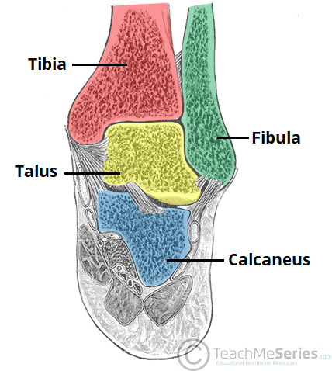

Slide 4
The ankle joint is formed by three bones; the tibia and fibula of the leg, and the talus of the foot:
The tibia and fibula are bound together by strong tibiofibular ligaments. Together, they form a bracket shaped socket, covered in hyaline cartilage. This socket is known as a mortise.
The body of the talus fits snugly into the mortise formed by the bones of the leg. The articulating part of the talus is wedge shaped – it is broad anteriorly, and narrow posteriorly:
Dorsiflexion – the anterior part of the talus is held in the mortise, and the joint is more stable.
Plantarflexion – the posterior part of the talus is held in the mortise, and the joint is less stable.

Slide 5
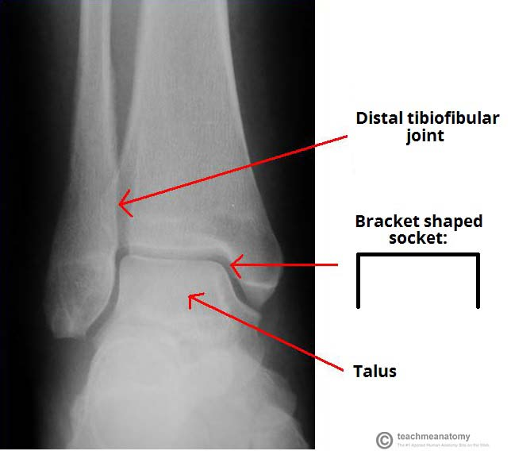

Slide 6
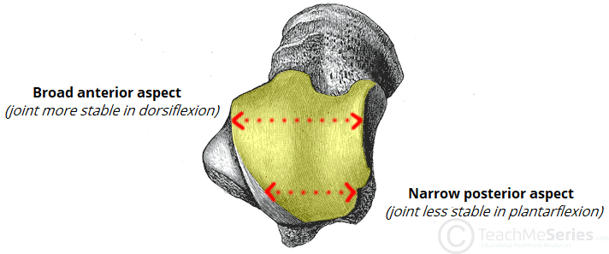

Slide 7
There are two main sets of ligaments, which originate from each malleolus.
Medial Ligament
The medial ligament (or deltoid ligament) is attached to the medial malleolus (a bony prominence projecting from the medial aspect of the distal tibia).
It consists of four ligaments, which fan out from the malleolus, attaching to the talus, calcaneus and navicular bones. The primary action of the medial ligament is to resist over-eversion of the foot.

Slide 8
The lateral ligament originates from the lateral malleolus (a bony prominence projecting from the lateral aspect of the distal fibula).
It resists over-inversion of the foot, and is comprised of three distinct and separate ligaments:
Anterior talofibular – spans between the lateral malleolus and lateral aspect of the talus.
Posterior talofibular – spans between the lateral malleolus and the posterior aspect of the talus.
Calcaneofibular – spans between the lateral malleolus and the calcaneus.

Slide 9
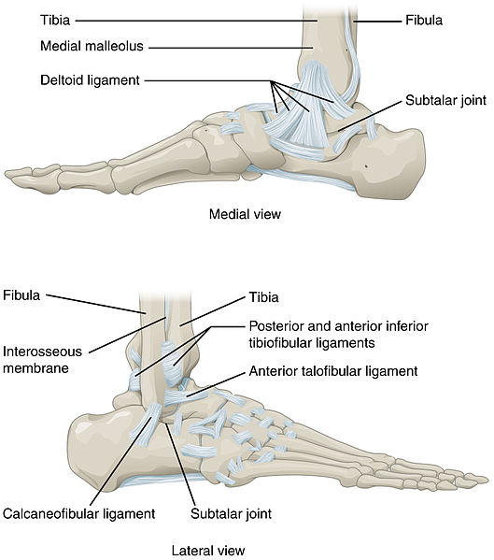

Slide 10
Clinical significance
The ankle joint and associated ligaments can be visualised as a ring in the coronal plane:
The upper part of the ring is formed by the articular surfaces of the tibia and fibula.
The lower part of the ring is formed by the subtalar joint (between the talus and the calcaneus).
The sides of the ring are formed by the medial and lateral ligaments.
A ring, when broken, usually breaks in two places
When dealing with an injury to the ankle joint, a clinician must bear this in mind. For example, a fracture of the ankle joint may occur in association with ligament damage (which would not be apparent on x-ray).

Slide 11
The ankle joint is a hinge type joint, with movement permitted in one plane.
Thus, plantarflexion and dorsiflexion are the main movements that occur at the ankle joint. Eversion and inversion are produced at the other joints of the foot, such as the subtalar joint.
Plantarflexion – produced by the muscles in the posterior compartment of the leg (gastrocnemius, soleus, plantaris and posterior tibialis).
Dorsiflexion – produced by the muscles in the anterior compartment of the leg (tibialis anterior, extensor hallucis longus and extensor digitorum longus).

Slide 12
The arterial supply to the ankle joint is derived from the malleolar branches of the anterior tibial, posterior tibial and fibular arteries.
Innervation is provided by tibial, superficial fibular and deep fibular nerves.

